Slide 1

CompTIA Security+ Certification - SYO-601 Exam Training

Slide 2


Domain 5: Governance, Risk, and Compliance

Slide 3
Summarizing Risk Management Concepts

Slide 4


Learning Objectives
By the end of this lesson, you will be able to:
Analyze risk management processes and concepts
Illustrate business impact analysis concepts Interpret risk awareness
Analyze disaster and its types

Slide 5

Risk Management Processes and Concepts

Slide 6
Risk Management Processes
The measure of uncertainty is called risk. Risk management is the process of using various approaches to manage all the aspects of risk.
Five phases of risk management are as follows:
Identification of Essential Functions
Risk Response Identification
Search of Vulnerability
Business Impact Analysis
Threat Identification

Slide 7

Risk Assessment
The tasks carried out by cyber security risk management are as follows:
Identifies information assets (such as hardware, systems, laptops, customer data, and intellectual property) that may be compromised in the event of a cyber-attack.
Identifies potential risk of those assets that can be measured in terms of likelihood and impact.

Slide 8

Risk Assessment
The following is a list of the new risk management framework that most organizations and
institutions follow:
1
Enterprise Risk Management (ERM) frameworks
2
Risk and Control Self-Assessment (RCSA)
3
Risk and Control Assessment (RCA)

Slide 9

Risk Types
As a result of specific threat and vulnerability scenarios, numerous risks are identified.
Following are the types of risk:
External
01
06
Legacy systems
Software compliance or licensing
Internal
02
05
Intellectual Property (IP) theft
Multi party
03
04

Slide 10
Quantitative Risk Assessment
Risk analysis uses quantitative methods to evaluate likelihood and impact.
It aims to assign concrete values to each risk factors, such as:
Single Loss Expectancy (SLE)
Exposure Factor (EF)
Annualized Loss Expectancy (ALE)
Annualized Rate of Occurrence (ARO)
Limitations
Difficulty of forecasting likelihood
Difficulty of assessing impact or cost

Slide 11


Qualitative Risk Assessment
Following are the approaches used by qualitative risk assessment:
01
It avoids the complexities associated with quantitative risk assessment.
02
It focuses exclusively on the identification of significant risk
factors.
03
It emphasis on the opinion of an individual regarding significance of risk factor.

Slide 12
Qualitative Risk Assessment
In qualitative risk assessment, assets and risks are classified in straightforward ways.
It uses heat map matrix and security categorization methods to classify assets and risks.
Heat Map or Traffic Light Impact Matrix
Security Categorizations
 | Negligible | Minor | Moderate | Significan t | Severe
Very Likely | Low Med | Medium | Med Hi | High | High
Likely | Low | Low Med | Medium | Med Hi | High
Possible | Low | Low Med | Medium | Med Hi | Med Hi
Unlikely | Low | Low Med | Low Med | Medium | Med Hi
Very Unlikely | Low | Low | Low Med | Medium | Medium
In security categorizations, potential impacts are classified as
Medium
Low High

Slide 13

Risk Management Strategies
The inherent risk is the level of risk before any type of mitigation measures are attempted.
It is measured using qualitative and quantitative analysis.
The level of risk can be reduced by following these two strategies:
Risk posture and prioritization Identification and prioritization of risk response option
Risk mitigation or remediation
Reduction of the effects of risk factors
1
2

Slide 14
Risk Management Strategies
These strategies aim at reducing the impact level of risk.
Risk posture and prioritization
It identifies and prioritizes the following to reduce the impact level of risk.
Regulatory requirements
High value asset, regardless of threat likelihood
Threats with high likelihood
Procedures, equipment, or software that increase the likelihood of threats
Return on Security Investment (ROSI)
Risk mitigation or remediation
It deploys countermeasures to reduce likelihood or impact, or both.

Slide 15
Risk Avoidance and Risk Transference
The basic methods of risk management are:
Risk Avoidance
Risk Transference
It means transferring risk to third party.
It uses cybersecurity insurance for
protection against risk.
It limits to transference.
It means stop doing risk-bearing activities.
It is often not a credible option.

Slide 16
Risk Acceptance and Risk Appetite
Following methods are used for managing risks:
Risk Acceptance or Tolerance
Assess and monitor the risk without ignoring it but
no countermeasures in place
01
Control Risk
Manage loss of countermeasure effectiveness over time
Residual Risk
02 04
Evaluate likelihood and impact after mitigation
03
Risk Appetite
Tolerate certain level of risk to establish at an organization or project level

Slide 17
Risk Awareness
Risk factors should be communicated to stakeholders through risk registers.
Following methods are used in risk register to represent results of risk assessments:
Graphs
2
Risk matrix or heat map
1
Relevance to workflows
3

Slide 18
Business Impact Analysis Concepts

Slide 19
Business Impact Analysis
These following two approaches are used for analysis of risk impact on business:
It reports threat scenarios.
It calculates impact as costs.
It justifies and prioritizes investment in security
controls.
Business Impact Analysis (BIA)
Business Continuity Planning or Continuity Of Operations Planning (COOP)
It identifies controls and processes that maintain critical workflows.

Slide 20











Mission Essential Functions
In contrast to Primary Business Functions (PBF), Mission Essential Function (MEF) cannot be deferred. It is governed by four main metrics:
Maximum Tolerable Downtime (MTD)
1
Maximum Tolerable Downtime (MTD)
Disaster
Recovery Time Objective (RTO)
Work Recovery Time (WRT)
2
Recovery Time Objective (RTO)
Work Recovery Time (WRT)
Time
BKP
BKP
Workflow
Workflow
Workflow
3
BKP
BKP BKP
BKP
BKP
Server
Server
Server
4
Recovery Point Objective (RPO)
Recovery Point Objective (RPO)
Metrics governing mission essential functions

Slide 21
Identification of Critical Systems
Identification of critical systems is essential to support resiliency of MEF and PBF.
It is performed by compiling inventory of the following two aspects:
Supporting Asset Types
Business Process Analysis (BPA)
The asset types which are supported include:
People
Tangible assets
Intangible assets
Procedures
BPA should identify the following factors:
Input
Hardware
Staff and other resources
Output
Process flow

Slide 22
Single Point of Failure
A SPoF is an asset that causes the entire workflow to fail if it is damaged or is unavailable.
Some of the main KPIs relating to service availability are as follows:
Mean Time To Failure (MTTF) and Mean Time Between Failure (MTBF)
It determines how likely failures are to occur.
It determines provision for redundancy.
It measures time taken to correct fault.
It affects Overall Recovery Time (RTO).
Mean Time To Repair (MTTR)

Slide 23
Disasters
Disaster is an event that threatens mission essential functions. Types of disasters include:
Internal vs. External Disaster
Internal disasters are caused by attackers who have privileged access and external
disasters are caused by attackers who have no privileged access.
External disasters impact supply chain.
Person-Made Disaster
Person-made disaster can be internal or external disaster, and it is caused by human.
It can be accidental or malicious.
Environmental Disaster
Environmental disaster cannot be prevented by human.

Slide 24

Site Risk Assessment
A site risk assessment evaluates exposure to the following types of factor:
01
Risk from natural disaster
02
Risk from disruption to utilities
03
Risk to health and safety

Slide 25
Disaster Recovery Plans
Disaster Recovery Plans (DRPs) define the procedures to recover a system to a working state
following a disaster-level event.
Following are the steps in disaster recovery plans:
01
Identify scenarios for natural and non-natural disaster, and options for protecting systems. It accounts for threat modelling, risk, and cost assessment.
02
Identify tasks, resources, and responsibilities to respond to a disaster.
03
Train staff in the disaster planning procedures and how to react well to change.
04
Notify stakeholders and agencies.

Slide 26
Functional Recovery Plans
Four principal methods for assessing the functionality and effectiveness of recovery plans are:
Walkthrough, workshop, and orientation seminar
Tabletop Exercise
It is presentation- and description- oriented.
It is facilitator-led discussion scenarios.
Functional Exercise
Full-Scale Exercise
It is action-based engagements simulating major events.
It is more typical of public agencies.
It is action-based engagements using
simulations.

Slide 27
Key Takeaways
The measure of uncertainty is called risk. Risk management is the process of using various approaches to manage all the aspects of risk.
They are five phases of risk management.
Risk factors should be communicated to stakeholders through risk registers.
Disaster Recovery Plans (DRPs) describe the specific procedures to follow to recover a system or site to a working state following a disaster-level event.

Slide 28
CompTIA Security+ Certification - SYO-601 Exam Training

Slide 29
Domain 5: Governance, Risk, and Compliance

Slide 30
Implementing Cybersecurity Resilience

Slide 31
Learning Objectives
By the end of this lesson, you will be able to:
Analyze redundancy strategies
Apply backup strategies
Implement cybersecurity resilience strategies
Illustrate configuration management

Slide 32
Redundancy Strategies

Slide 33
High Availability
High availability is one of the most significant characteristics of a robust system.
A few important terms include:
Availability
Online duration of the system in percentages, measured over a set period, usually a year.
Downtime
Total amount of time that the system is unavailable and is the corollary of availability.

Slide 34

High Availability
Following are the factors associated with availability and downtime:
Maximum Tolerable Downtime (MTD)
It offers availability requirement for business.
Availability Time
It is defined as 24x7 (24 hours for all seven days).
It is defined as 99% up to 99.99999% for critical systems.
Downtime
It is calculated as Total Schedule Services + Unplanned outages.

Slide 35
High Availability
Other factors of high availability are :
Fault Tolerance and Redundancy
Scalability and Elasticity
Scalability refers to scaling up and scaling out resources and their power and Elasticity refers to system's ability to handle changes on demand in real time.
Fault tolerance can be achieved through provisioning redundancy for critical components from single point of failure.

Slide 36
Power Redundancy
A reliable power source is required for all sorts of computer systems to function. The operation of various computer systems requires a reliable power supply.
Electrical events such as voltage spikes or surges can cause computers and network equipment to hang. Power outages or blackouts can cause equipment to malfunction.
Power management is the use of systems to ensure that equipment is protected from such disasters and network. Operations can continue without interruption or rapidly recovered.

Slide 37

Power Redundancy
Some possible power recovery options are :
Dual power supplies
It provides component redundancy for server chassis
Managed Power Distribution Units (PDUs)
It protects against spikes, surges, and brownouts.
It is monitored remotely.
Battery backups and Uninterruptible Power Supply (UPS)
It uses battery backup at component level.
It uses UPS battery backups at servers and appliances level.
Generators
It can power entire facility for several days at a time.

Slide 38
Network Redundancy
Network redundancy helps to ensure network availability and reduce the risk of failure.
It can be achieved through:
Switching and routing
It designs network with multiple paths.
Network Interface Card (NIC) or adapter teaming
It consists of adapters with multiple ports or just multiple adapters.
It usually provides more bandwidth (except during failover).
Load balancers
It uses load balancing switch to distribute workloads.
It enables cluster provision
for multiple redundant servers to share data and session information.
02
01
03

Slide 39

Disk Redundancy
Disk and storage resources are critically dependent on redundancy.
Backup ensures data integrity when disk fails.
Below mentioned steps are employed to restore data from backup:
1
Installing a new storage unit
2
Restoring the data
3
Testing the system configuration

Slide 40
Disk Redundancy
Disk redundancy ensures that the server can continue to function even if one or more storage devices fail. Following are types of disk redundancy:
Redundant Array of Independent Disks (RAID)
It provides redundancy for
many disks.
Multipath
It focuses on controlling and cabling redundancy for
storage devices.
1
2

Slide 41
Disk Redundancy
Some of the most implemented types of RAID are:
RAID 1
It uses mirroring technique.
It has only 50% storage efficiency.
RAID 5 and RAID 6
It uses striping with parity technique and 3-4 disks for writing.
It has better storage efficiency than RAID I.
Nested RAID
It improves performance or redundancy.
(RAID 0)
It increases server performance.

Slide 42

Geographical Redundancy and Replication
Data replication is the technique used to maintain exact copies of data at more than one location. It can be used in the following context:
Local Storage (RAID)
Storage Area Network (SAN)
Virtual Machine(VM)
Database

Slide 43
Geographical Redundancy and Replication
The techniques used for data replication are as follows:
Replication Context
Local storage (RAID)
Storage Area Network (SAN)
Database
Virtual Machine (VM)
Geographic Dispersal
Data replicating hot and warm sites that are physically distant from one another

Slide 44
Geographical Redundancy and Replication
Synchronous and Asynchronous Replication
Synchronous: must be written at both sites
Asynchronous: one site is primary and the others secondary
Optimum distances between data centers
On-Premises vs. Cloud
On-premises: Cost incurred is more as sites are geographically dispersed
Cloud: Cost is less as local and geographic redundancy are in-built in the system

Slide 45
Backup Strategies

Slide 46

Backups and Retention Policy
Certain types of backup are used in all disaster recovery and business continuity plan.
Backups must be properly planned and governed by policies in terms of execution and frequency.

Slide 47
Backups and Retention Policy
Data retention must be considered in the following aspects:
Short term retention
It comprises of version control and recovery from
corruption or malware.
1
2
Long term retention
It consists of regulatory or business
requirements.
3
Recovery window
It is determined by BCP’s Recovery Point
Objective (RPO).

Slide 48
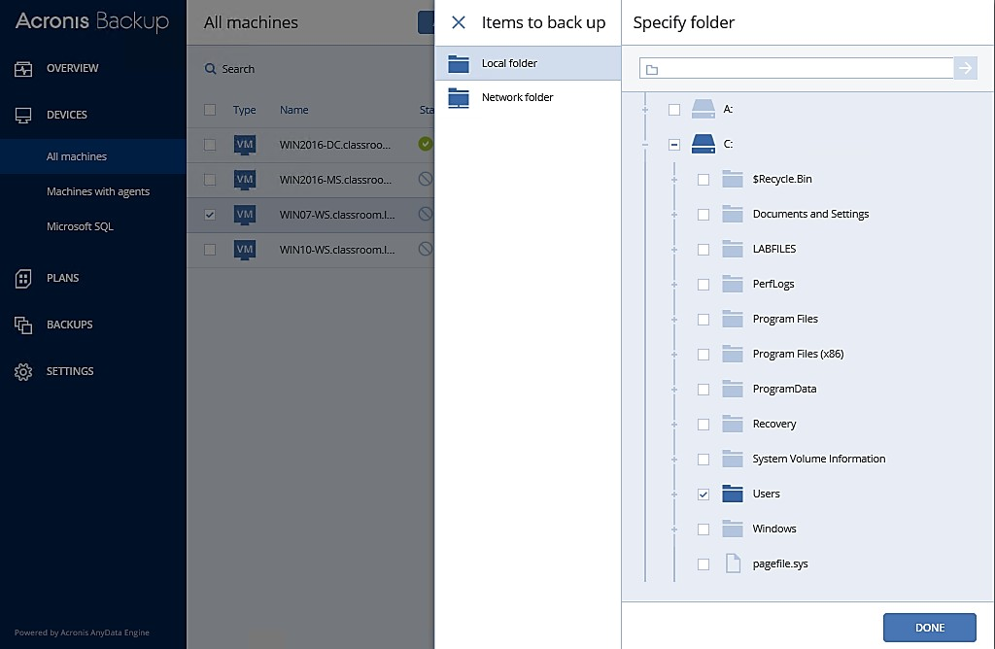
Backups and Retention Policy
Screenshot of performing a backup using Acronis backup:

Slide 49
Backup Types
There are generally three types of backups available such as:
Type of Backup | Type of Data Select | Backup or Restore Time | Archive Properties
Full Backup | All of the data you've chosen, irrespective of when it was last backed up | High or Low | Erased
Incremental Backup | New file with last updated files with last backup | Low or high | Erased
Differential Backup | All new and updated file before last backup | Moderate | Un Erased

Slide 50
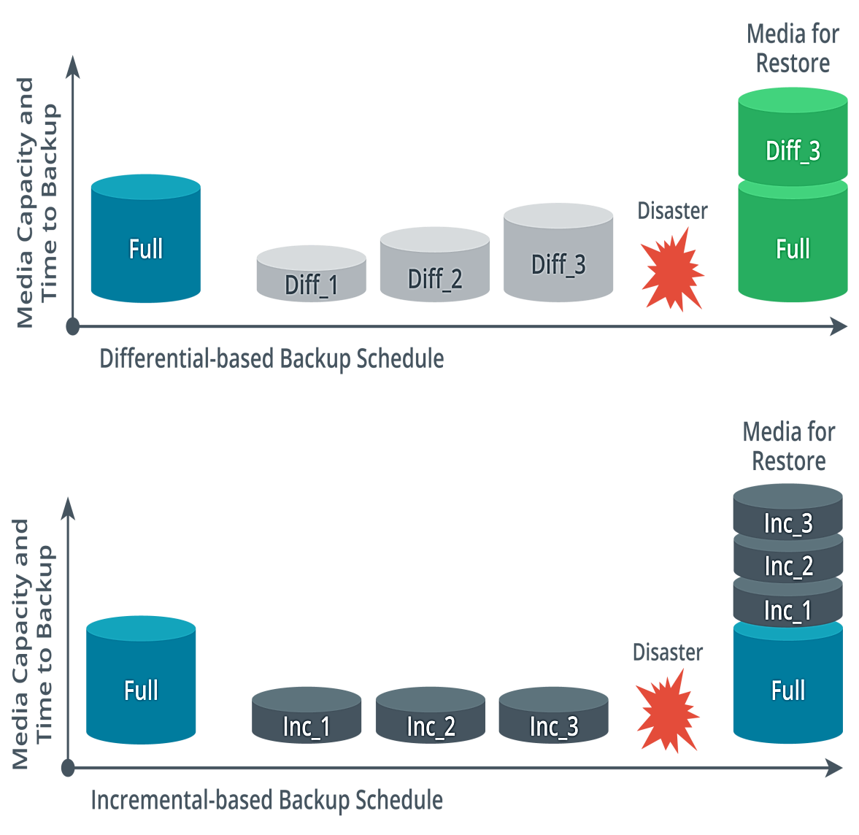
Backup Types
The screenshot below refers to Differential-based backup schedule and Incremental-based backup schedule.

Slide 51
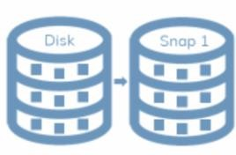
Snapshots
A snapshot is a feature of file system allowing open file copy.
The two measures used by snapshots are:
Volume Shadow Copy Service (VSS)
VM snapshots and checkpoints
1
2

Slide 52
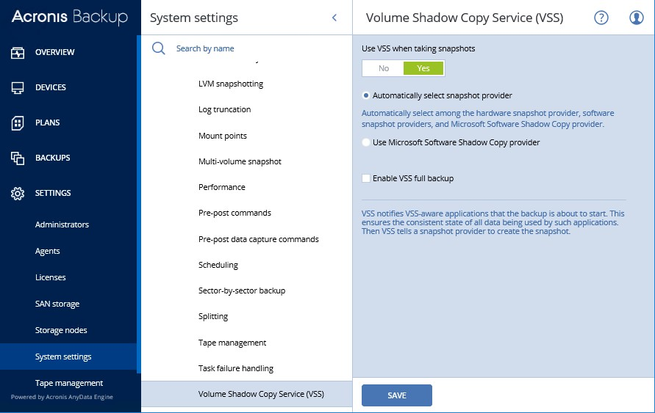
Snapshots
Image-based backup are created by copying an operating system installation.
Screenshot of configuring VSS settings in Acronis backup:

Slide 53
Backup Storage Issues
Many backup solutions employ encryption and access control to ensure security for backup data.
Still, many issues arise during backup storage, such as:
Offsite Storage
2
Online vs. offline backups
1
3
3-2-1 rule

Slide 54
Backup Storage Issues
Many backup solutions employ encryption and access control to ensure security for backup data.
Still, many issues arise during backup storage, such as:
Offsite Storage
Online vs. Offline Backups
3-2-1 rule
The offsite media must be physically brought onsite.
Distance consideration refers to how far the backup data should be kept from primary site to protect it from any breach.
Network or cloud backup can also be used as a measure for data security.
Online backups are available for speedy restore operations.
Offline backups offer better protection but are a risk to online backup data.
It states that user should have three copies of your data, across two media types, with one copy held offline and offsite.

Slide 55
Backup Media Types
Backup media can be divided into following types:
Disk
SOHO backups lack enterprise-level capacity and manageability.
Network Attached Storage (NAS)
It addresses storage at a file level with no offsite option.

Slide 56
Backup Media Types
Tape
It is used for enterprise-level capacity and manageability.
Storage Area Network (SAN) and Cloud
It addresses storage devices at the block level, and it is highly configurable.
It uses various storage technologies to implement performance tiers.

Slide 57

Restoration Order
A complex facility, such as a data centre or campus network, must be restored in a carefully planned sequence. If systems are restored back online in an uncontrolled manner, then:
There is significant risk of causing additional power problems or issues.
These issues are due to unmet dependencies between different
appliances and servers.
Complex facility should be restored in a carefully planned manner.

Slide 58
Restoration Order
Order of restoration is as follows:
1
Power delivery systems
Switch infrastructure then routing appliances and systems
Network security appliances
4
Critical network server
5
Backend and middleware, and verify data integrity
6 Front-end applications
7
Client workstations and devices, and client browser access

Slide 59


Non-Persistence
Non-persistence means that any given instance is completely static in terms of processing
function and various mechanisms. It ensures:
Rollback to known configuration
Snapshot or revert to known state
Live boot media

Slide 60
Non-Persistence
The types of mastering instructions used by automation system while provisioning a
new or replacement instance are:
Master image
It is the gold copy of a server instance, with the OS, applications, and patches installed and configured.
Automated build from template
It is the build instructions for an instance and provides configuration validation.
1
2

Slide 61
Cyber security Resilience Strategies

Slide 62
Configuration Management
Under ITIL, configuration management is implemented using the following elements:
People, processes or things
Contribute to the delivery of an IT service
Service Assets
These are assets that require configuration management
procedures.
Configuration Items (CIs)
Configuration settings template of device or VM instance
Records performance baselines
Baseline Configuration

Slide 63
Configuration Management
Tools and database to perform DB operations
Information is present in spreadsheets and diagrams
CMS
The diagrams include:
Workflows
Physical and logical network topologies
Network rack layouts
Creating and Updating Diagrams

Slide 64
Asset Management
Asset management tracks inventory or asset management database that usually contains valuable inventory. Various features of asset management are:
Asset identification and standard naming conventions
Internet Protocol (IP) schema
Assets can be identified using barcodes and RFID tags.
Within each subnet, the schema should identify IP addresses reserved for manual or static allocation vs. DHCP address pools.
Standard naming conventions for asset IDs make the environment more consistent.
IP Address Management (IPAM) software suites are usually used to monitor IP usage.
Attribute fields and tags also help in identification and naming.

Slide 65
Change Control vs. Change Management
Service management standards distinguish change control as distinct procedures for
requesting and approving changes within an overall change management process.
Change Control
Change Management
It assess whether a change should be made or not
Changes can be reactive, proactive, or
risk.
The need for change is captured in a Request for Change (RFC) document.
Change Advisory Board (CAB) is used to manage separate project that requires approval.
It ensures that changes are applied
with minimum disruption.
Every change should be accompanied by a rollback plan.

Slide 66
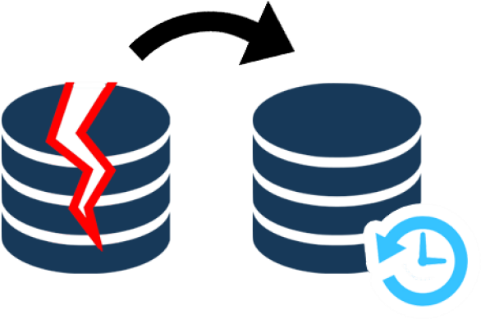
Site Resiliency
Alternate processing sites or recovery sites provide redundancy for damage of resources stored on the primary site.
Operations are designed to perform failover to alternate processing site or system.

Slide 67
Site Resiliency
Site resiliency can be described as :
Warm site
Refers to some delay or manual configuration before failover occurs
02
Hot site
Refers to instantaneous failover
Cold site
Refers to significant delay and configuration before failover can occur
01
03

Slide 68
Diversity and Defense in Depth
Layered security is typically seen as improving cyber security resilience, because it provides
defense in depth. The key aspects to diversity are:
Technology and Control Diversity
It is a mix of technical, administrative, and physical controls.
It provides different classes and types of controls.
It deploys controls to prevent, deter, detect, and correct.
Vendor Diversity
It uses more than one supplier.
It provides interoperability and can reduce training and support costs.
Crypto Diversity
It is an adopted blockchain-based IAM method.
It manages selection of algorithms and implementations of cryptography

Slide 69
Deception and Disruption Strategies
Deception strategies are asymmetric in attack and defense. Active defense means an
engagement with the adversary.
Fake or decoy asset is a type of active defense, and it uses the following strategies:
Honeypots, honeynets, and honeyfiles
Breadcrumbs

Slide 70

Deception and Disruption Strategies
Active defense uses disruption strategies and adopts some of the obfuscation strategies used by malicious actors. Examples of disruption strategies include:
Decoy directories and resources
Bogus DNS records
Port spoofing
DNS sinkholes

Slide 71
Key Takeaways
High availability is one of the most significant characteristics of a
robust system.
Disk redundancy ensures that the server can continue to function even if one or more storage devices fail.
A snapshot is a feature of file system allowing open file copy. Layered security is typically seen as improving cyber security
resilience, because it provides defense in depth.
Deception strategies are asymmetric in attack and defense

Slide 72
CompTIA Security+ Certification - SYO-601 Exam Training

Slide 73
Domain 5: Governance, Risk, and Compliance

Slide 74
Explaining Physical Security

Slide 75
Learning Objectives
By the end of this lesson, you will be able to:
Analyze physical site security controls Illustrate physical host security controls
Elaborate sensor systems List data sanitization tools

Slide 76
Importance of Physical Site Security Controls

Slide 77
Physical Security Controls
Physical access controls are security measures that restrict and monitor access to specific physical areas or assets. Various ways to achieve them are :
Authorization
It creates barriers around a resource so that access can be controlled through defined entry and exit points.
Authentication
It creates access lists and identification mechanisms to allow approved members through barriers.
02
Accounting
It keeps a record of when entry or exit points are used and detects security breaches.
01
03

Slide 78

Site Layout, Fencing, and Lighting
Site planning can be done using the following principles:
01
Use zone-based design to accommodate traffic flows and surveillance.
02
Use signage to tighten the security.
03
Use industrial camouflage to protect high value assets and to draw out potential threat actors.

Slide 79



Site Layout, Fencing, and Lighting
Features of embedded systems are:
Barricades and entry or exit points
Fencing
Lighting
It is used to protect exterior of a building.
It makes the staff feel secure.
It is used to channel people through defined entry and exit points.
It also helps in assisting surveillance to prevent any security threats.

Slide 80
Gateways and Locks
Locks are fitted to secure a gateway. Lock types can be categorized as follows:
Physical (conventional or deadbolt)
It is a conventional lock that prevents the door handle from being operated without the use of a key.
Electronic
It is a smart lock that uses cipher combination. It may be opened using a magnetic swipe card or feature a proximity reader.

Slide 81
Gateways and Locks
Biometric
It is integrated with biometric scanner.
Cable locks
It is attached to a secure point on the device chassis.

Slide 82
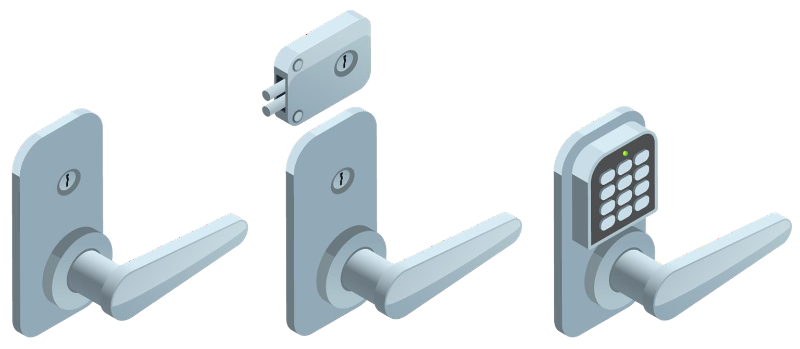
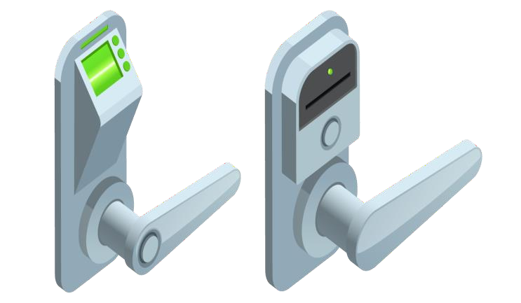
Gateways and Locks
Examples of generic locks are:
From left to right, you have a standard key lock, a deadbolt lock, and an electronic keypad lock.
From left to right, a biometric thumbprint scanner lock and a token-based key card lock.

Slide 83
Gateways and Locks
An unauthorized user may tailgate behind an authorized user.
This risk can be mitigated by installing the following gateways:
Turnstile
Mantrap
A mantrap is where one gateway leads to an enclosed space protected by another barrier. It is an access control mechanism.
A turnstile is a type of gateway that only allows one person through at a time.

Slide 84

Physical Attacks Against Smart Cards and USB
Certain smart cards used as passkeys for electronic locks are vulnerable to
cloning and skimming attacks.
Skimming
It refers to using a counterfeit card reader to capture card details and then to create a duplicate of the card.
Card cloning
It refers to making one or more copies of an existing card.
1
2
Malicious USB charging are also vulnerable for juicejacking attacks. It is protected using USB data blocker.
Bank-issued smart cards, such as Electron, MasterCard, Visa can be vulnerable through the magnetic strip that is retained for compatibility.

Slide 85





Alarm and Sensor Systems
When designing the security for premises, necessary alarms should be in place to prevent
misuse of various entry points. Types of alarms include:
Noise detection
03
Motion detection
Proximity readers
02
04
Circuit
01
Duress
05

Slide 86

Security Guards and Cameras
Security guards provide visual deterrence and have intuition to potential security breaches.
Their benefits are :
They man a campus’ entry point
They help to operate surveillance mechanisms.
They respond to alarms in case of any security threat and react to the situation as required.

Slide 87





Security Guards and Cameras
Remote surveillance and monitoring can be done using:
Object detection
03
Motion recognition
Robot sentries
02
04
Video or CCTV 01
Drones or UAV
05

Slide 88
Reception Personnel and ID Badges
Challenge policy is an important part of surveillance. This helps to set response in
given situation and defeat social engineering attacks. It is achieved by following means:
Reception Personnel
and Visitor Logs
Two-Person Integrity
or Control
ID badges
Photographic ID badge having name and access details is used
Color coding technique used to verify access for each zone
Staffs without an ID badge
should be challenged
Electronic lock logs access attempts
Sign-in and sign-out sheet used to record authorized access
Mandatory logging of visitor details
High-security zones in reception, staffed by two staffs always
Integrity for entry control is provided and the risk of insider threat is reduced

Slide 89
Importance of Physical Host Security Controls

Slide 90

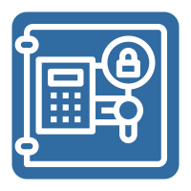
Secure Areas
Secure areas such as server rooms and data centers are mostly protected by lockable cabinets and colocation cages to prevent any security issues.
An air gapped host or a demilitarized zone is one that is not
physically connected to any network.
Safes are usually key operated or password protected, whereas vault is a room that is hardened against unauthorized entry by physical means.

Slide 91
Protected Distribution and Faraday Cages
Physical security is implemented in the following ways:
Protected Cable Distribution or Protected Distribution System(PDS)
Faraday cage
1. Transient Electromagnetic Pulse Emanation Standard (TEMPEST) is defined as a means of shielding the signals.
It prevents eavesdropping.
It prevents or delays cable cutting DoS.

Slide 92
Heating, Ventilation, Air Conditioning
Techniques such as Heating, Ventilation, and Air Conditioning (HVAC) help to control cooling,
warming, humidity, and dust control.
Moisture detection and temperature detection sensors help to maintain optimum temperature and keep the humidity in control.
HVAC sizing are equipment wattage that are measured in British Thermal Units (BTU) per hour.
Positive air pressure created by HVAC are used to remove contaminants.

Slide 93

Hot and Cold Aisles
Data center designed should optimize or maximize air flow across the server or racks.
If multiple racks are used, install equipment so that servers are placed back-to-back, which is known as hot aisle or cold aisle arrangement.
Hot and cold aisles don’t allow contamination of cooled air by warmed air.

Slide 94
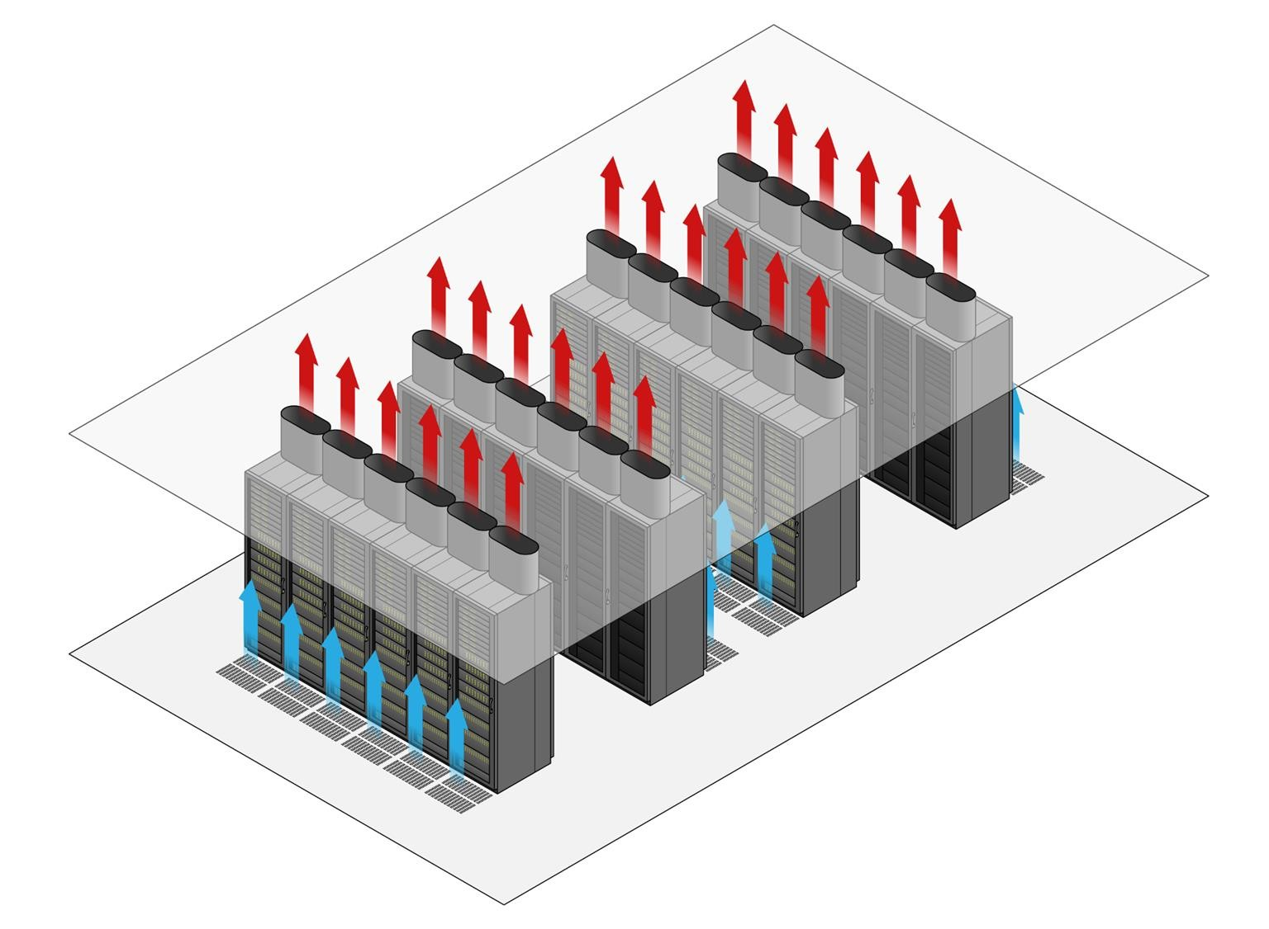
Hot and Cold Aisles
Hot aisle containment design:
Source: htttps://www.telecominnovations.com/services/data-containment/

Slide 95

Fire Detection and Suppression
Organizations use various methods to detect and suppress fires as dictated by health and safety legislation. Basic elements of fire safety are:
Fire exits and
evacuation procedures
Smoke or flame
detectors or alarms
Fire-resistant building design
Personal fire extinguishers like class C are used around electrical
hazard for domestic purposes.

Slide 96

Fire Detection and Suppression
Premises may be fitted with an overhead sprinkler system where wet-pipe sprinklers are automatically triggered by heat and discharge water. Types of sprinklers are:
Dry pipe
Pre-action
Halon
Clean agent

Slide 97

Secure Data Destruction
Media sanitization and remnant removal refer to erasing data from storage devices.
Data remnants can use sanitization approach by destroying the media and rendering it unusable.
Several physical destruction options are:
Degaussing
Burning or incineration
Pulverizing
Shredding and pulping
Physical destruction is contracted to a third party and certification of destruction is obtained.

Slide 98
Data Sanitization Tools
Data sanitization tools help in secured disposal of electronic data remnants.
The various methods of data sanitization are:
Overwriting or Disk Wiping
Zero filling and multiple passes are the two types of overwriting or disk wiping.
Secure Erase (SE)
SE can be performed either on Hard Disk Drives (HDD), Solid State Drives (SSD), or flash media.
Instant Secure Erase (ISE)
With an SED(Self-Encrypting Drive), all data on the drive is encrypted using a media encryption key.

Slide 99
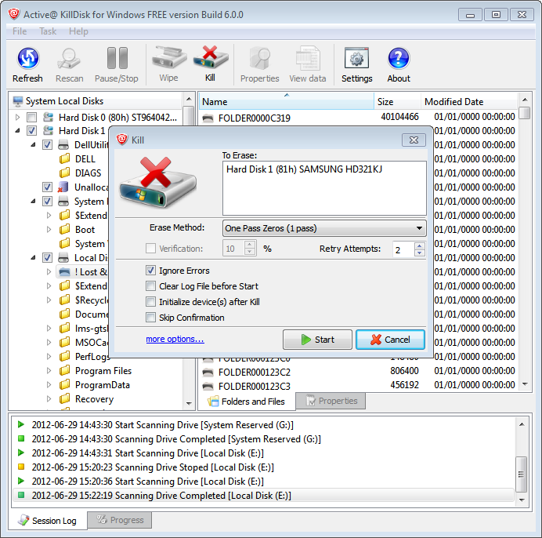
Data Sanitization Tools
Active KillDisk data wiping software window

Slide 100
Key Takeaways
Physical access controls depend on the same access control
fundamentals as the network or operating system security.
Secure areas, such as server rooms and data centers are mostly protected by lockable cabinets and colocation cages to prevent any security issues.
Personal fire extinguishers like class C are used around electrical hazard for domestic purposes.
Media sanitization and remnant removal refer to erasing data from storage devices.

